Slide 1
Managing Software Quality
Quality Management-Software Configuration Management-Managing Software organizations-Managing Software quality –Defect Prevention
Ch. 8

Slide 2
Quality Management
Quality Management Framework
Quality Program
Organizational Aspects of the Quality Program
Quality Program Organizational Relationships
Mapping Quality Program Functions to Project Organizational Entities
Ch. 8

Slide 3
Management
"The creation and maintenance of an internal environment
in an enterprise where individuals, working together in
groups, can perform efficiently and effectively toward the
attainment of group goals" (Koontz et al, 1980)
What Is Quality Management?
Quality management is the act of overseeing all activities and tasks that must be accomplished to maintain a desired level of excellence
Ch. 8

Slide 4
The Quality Management Framework
Object (entity);
• Process;
• Requirements;
• User;
• Evaluation;
• Measure and Measurement;
• Quality.

Slide 5
Object (Entity)
The types of objects (entities) to which quality can be applied include:
• Product;
• Process;
• Service;
• Resource;
• Artifact;
• Activity;
• Measure or metric;
• Environment;
• Collection of entities or objects

Slide 6
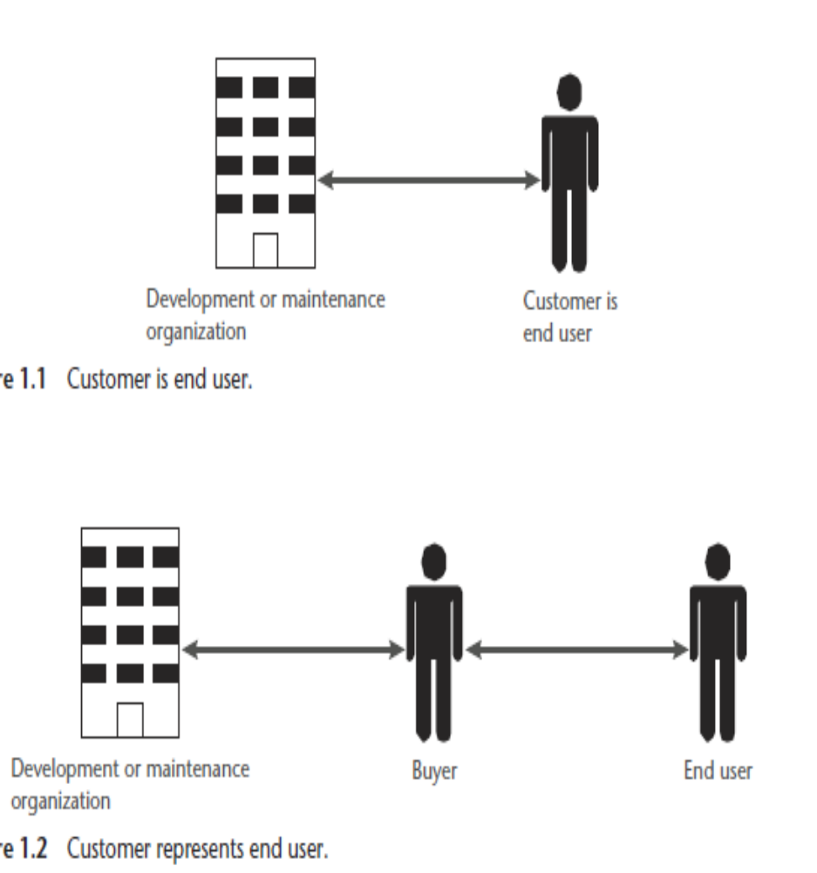
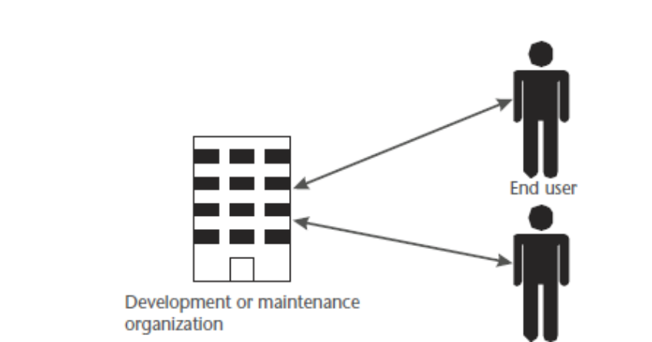
user

Slide 7
Quality
1.Attributes
An attribute is “a property or characteristic of an entity that can be distinguished
quantitatively or qualitatively by human or automated means,” from ISO 15939,
Software Engineering—Software Measurement Process. The word “attributes”
includes all specified requirements governing functional, performance, and other
specified characteristics such as adaptability, maintainability, and correctness [1, 9].
The attributes (i.e., requirements and other specified characteristics) are considered
the determinants of product or process quality.

Slide 8
Quality
2.Specifying Product Quality Using Attributes
For implementation of a product, one selects those attributes most significant to
the user community and evaluates, rates, or measures the product’s quality on how
well, or to what degree, the selected attributes meet those criteria for excellence.
Often, these attributes address only functionality and performance and ignore the
other attributes, often referred to as -ilities. The -ilities can be considered as attributes
that address fitness for use. Conceivably, “if we look at the issue of the software
meeting its requirements and if those requirements are solely functional and prescribe
no -ilities, then clearly the software can meet the requirements but could be
unable to fulfill any reasonable purpose
3.Considering User Needs

Slide 9
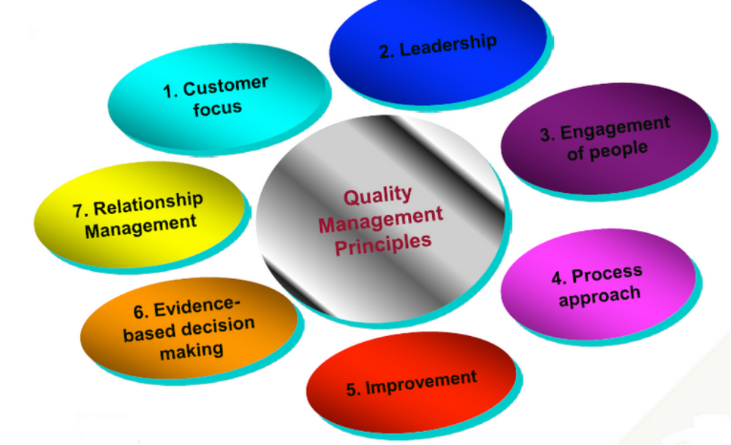
The ISO 9000:2015 and ISO 9001:2015 standard:
Seven principles of Quality management.

Slide 10
Elements of a Quality Management System
Quality Objectives
Quality Manual
Organizational Structure and Responsibilities
Data Management
Processes
Customer Satisfaction with Product Quality
Continuous Improvement
Quality Instruments
Document Control

Slide 11
Management tasks
Planning
Organizing
Staffing
Directing
Controlling
… and dealing with deviations from the plan
“Plan the work and work the plan”
Ch. 8

Slide 12
Management challenges
Balance conflicting goals
Deliver a high-quality product with limited resources
Organize an activity that is fundamentally intellectual
  this complicates the traditional techniques for productivity measurement, project planning, cost and schedule estimation
Ch. 8

Slide 13
Software productivity
How to define/measure it?
In terms of lines of code produced
  few tens per day
.. but what do engineers do?
  up to half their time spent in meetings, administrative matters, communication with team members
Ch. 8

Slide 14
Function points
A productivity measure, empirically justified
Motivation: define and measure the amount of value (or functionality) produced per unit time
Principle: determine complexity of an application as its function point
Ch. 8

Slide 15
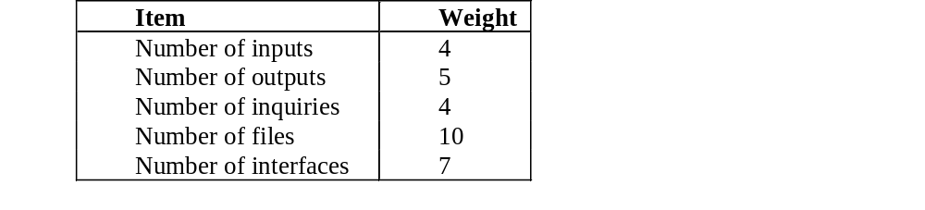
Function point definition
A weighted sum of 5 characteristic factors
Ch. 8

Slide 16
A byproduct
Function points used to measure the relative power of different languages
  compute number of source lines required to code a function point
  numbers range from 320 (assembler languages), 128 (C), 91 (Pascal), 71 (Ada83), 53 (C++, Java), 6 (“spreadsheet languages”)
Ch. 8

Slide 17
Size of code
Size of code produced per unit of time as productivity measure
  must define exactly what "size of code" means
    delivered source instructions (DSI)
    noncommented source statements (NCSS)
.. but how good is this metric?
Ch. 8

Slide 18
Factors affecting productivity
Professionals' capabilities
Product complexity
Schedule constraints
Previous experience
(Overly aggressive scheduling may have negative effect)
Ch. 8

Slide 19
People and productivity
Because software engineering is predominantly an intellectual activity, the most important ingredient for producing high-quality software efficiently is people
Large variability in productivity between engineers
Ch. 8

Slide 20
Cost estimation
We need predictive methods to estimate the complexity of software before it has been developed
  predict size of the software
  use it as input for deriving the required effort
Ch. 8

Slide 21
Generic formula for effort
PM = c.KLOC^{k}
Legend
  PM: person month
  KLOC: K lines of code
  c, k depend on the model
  k>1 (non-linear growth)
Initial estimate then calibrated using a number
of "cost drivers"
Ch. 8

Slide 22
Typical cost driver categories
Product
  e.g., reliability requirements or inherent complexity
Computer
  e.g., are there execution time or storage constraints?
Personnel
  e.g., are the personnel experienced in the application area or the programming language being used?
Project
  e.g., are sophisticated software tools being used?
Ch. 8

Slide 23
Cost estimation procedure
Estimate software size, and use it in the model’s formula to get initial effort estimate
Revise estimate by using the cost driver or other scaling factors given by the model
Apply the model’s tools to the estimate derived in step 2 to determine the total effort, activity distribution, etc.
Ch. 8

Slide 24
COCOMO models
Constructive Cost Model
  proposed by B. Boehm
  evolved from COCOMO to COCOMO II
Ch. 8

Slide 25
COCOMO
Size estimate based on delivered source instructions, KDSI
Categorizes the software as:
  organic
  semidetached
  embedded
    each has an associated formula for nominal development effort based on estimated code size
Ch. 8

Slide 26
Mode
Feature
Organic
Semidetached
Embedded
Organizational understanding of
Thorough
Considerable
General
product objectives
Experience in working with related
Extensive
Considerable
Moderate
software systems
Need for software conformance with
Basic
Considerable
Full
pre
-
es
tablished requirements
Need for software conformance with
Basic
Considerable
Full
external interface specifications
Concurrent development of
Some
Moderate
Extensive
associated new hardware and
operational procedures
Need for inn
ovative data processing
Minimal
Some
Considerable
architectures, algorithms
Premium on early completion
Product size range
Low
<50 KDSI
Medium
<300 KDSI
High
All sizes
Ch. 8

Slide 27
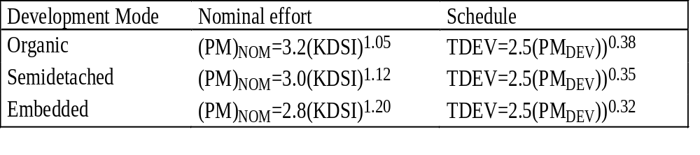
COCOMO nominal effort and schedule equations
Ch. 8

Slide 28
Ratings
Cost Drivers
Very low
Low
Nominal
High
Very
Extra
High
High
Product attributes
Required software
.75
.88
1.00
1.15
1.40
reliability
Data base size
.94
1.00
1.08
1.16
Product complexity
.70
.85
1.00
1.15
1.30
1.65
Comput
er attributes
COCOMO
scaling
factors
Execution time constraints
1.00
1.11
1.30
1.66
Main storage constraints
1.00
1.06
1.21
1.56
Virtual machine volatility*
.87
1.00
1.15
1.30
Computer turnaround time
.87
1.00
1.07
1.15
Personnel attributes
Anal
yst capability
1.46
1.19
1.00
.86
.71
Applications experience
1.29
1.13
1.00
.91
.82
Programmer capability
1.42
1.17
1.00
.86
.70
Virtual machine
1.21
1.10
1.00
.90
experience*
Programming language
1.14
1.07
1.00
.95
experience
Project
attributes
Use of modern
1.24
1.10
1.00
.91
.82
programming practices
Use of software tools
1.24
1.10
1.00
.91
.83
Required development
1.23
1.08
1.00
1.04
1.10
schedule
Ch. 8

Slide 29
Towards COCOMO II
COCOMO's deficiencies
  strictly geared toward traditional development life cycle models
    custom software built from precisely stated specifications
  relies on lines of code
Ch. 8

Slide 30
COCOMO II
A collection of 3 models
  Application Composition Model
  Early Design Model
  Post-Architecture Model
Ch. 8

Slide 31
Application Composition Model
Suitable for software built around graphical user interface (GUI) and modern GUI-builder tools
Uses object points as a size metric
  extension of function points
  count of the screens, reports, and modules, weighted by a three-level factor (simple, medium, difficult)
Ch. 8

Slide 32
Early Design Model
Used once requirements are known and alternative software architectures have been explored
Cost prediction based on function points and coarse-grained cost drivers
  e.g., personnel capability and experience
Ch. 8

Slide 33
Post-Architecture Model
Involves actual software construction and software maintenance
Cost prediction based on
  size (either as source instructions or function points, with modifiers to account for reuse)
  7 multiplicative cost drivers
  5 factors that determine the non linear growth of person-month costs in terms of size
Ch. 8

Slide 34
Project control
Ch. 8

Slide 35
Work Breakdown Structure
WBS describes a break down of project goal into intermediate goals
Each in turn broken down in a hierarchical structure
Ch. 8

Slide 36
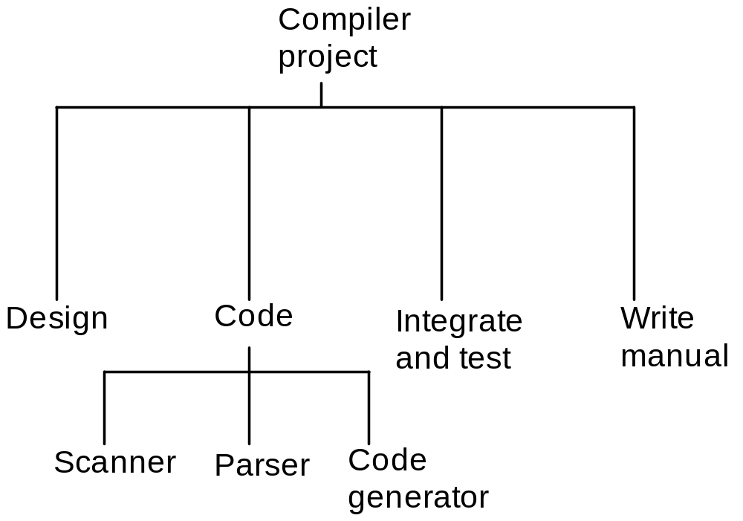
Example: a compiler project
Ch. 8

Slide 37
Gantt charts
A project control technique
Defined by Henry L. Gantt
Used for several purposes, including scheduling, budgeting, and resource planning
Ch. 8

Slide 38
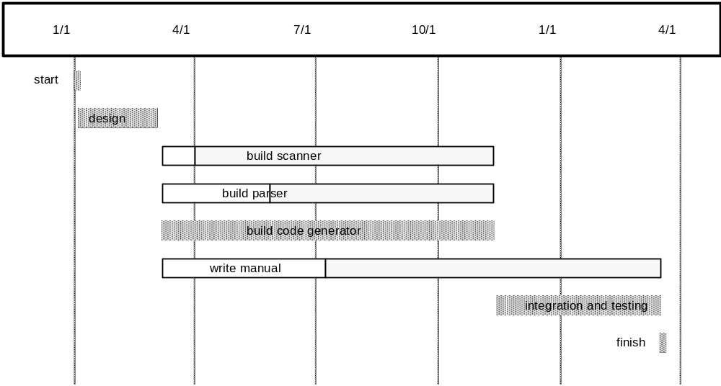
Example: a compiler project
Ch. 8

Slide 39

Example: scheduling activities
1/1
4/1
7/1
10/1
Darius
training
Marta
training
vacation
Leo
training
vacation
Ryan
training
vacation
Silvia
training
vacation
Laura
training
vacation
Ch. 8

Slide 40
PERT Charts
PERT (Program Evaluation and Review Technique) chart
  network of boxes (or circles)
    representing activities
  arrows
    dependencies among activities
      activity at the head of an arrow cannot start until the activity at the tail of the arrow is finished
Ch. 8

Slide 41
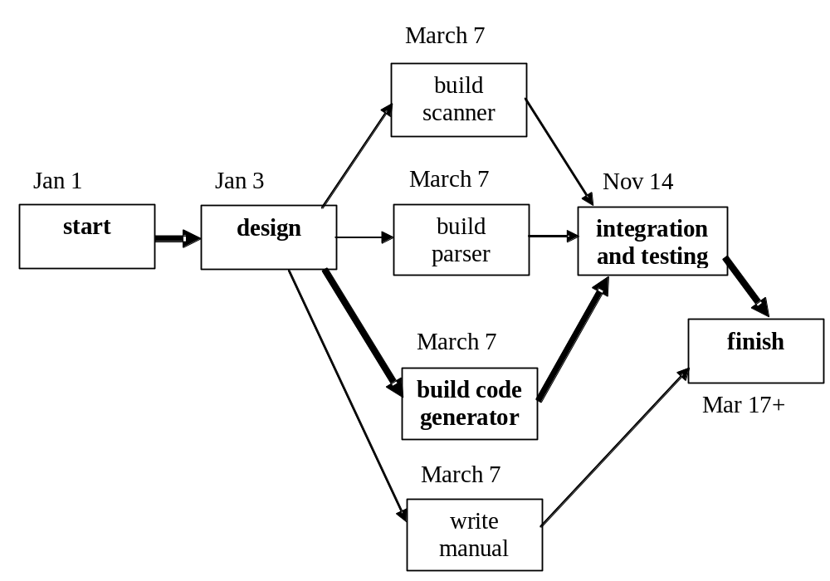
Example: a compiler project
Ch. 8

Slide 42
Analysis of PERT charts
Critical path for the project (shown in bold)
  any delay in any activity in the path causes a delay in the entire project
    activities on the critical path must be monitored more closely than other activities
Ch. 8

Slide 43
Gantt & PERT charts
Force the manager to plan
Show interrelationships among tasks
  PERT clearly identifies the critical path
  PERT exposes parallelism in the activities
    helps in allocating resources
Allow scheduling and simulation of alternative schedules
Enable the manager to monitor and control project progress and detect deviations
Ch. 8

Slide 44
Organization
An organization structure is used to structure the communication patterns among members of a team
Traditional team organization is hierarchical with a manager supervising a group or groups of groups
Other organizations have been tried in software engineering with some success
Ch. 8

Slide 45
Chief-programmer teams
A way to centralize the control of a software development team
  chief programmer (CF) responsible for design + reports to peer manager responsible for administration
  other members are a software librarian and programmers
    report to CF and are added to team when needed
Best when the solution may be understood and controlled by one chief architect
Ch. 8

Slide 46
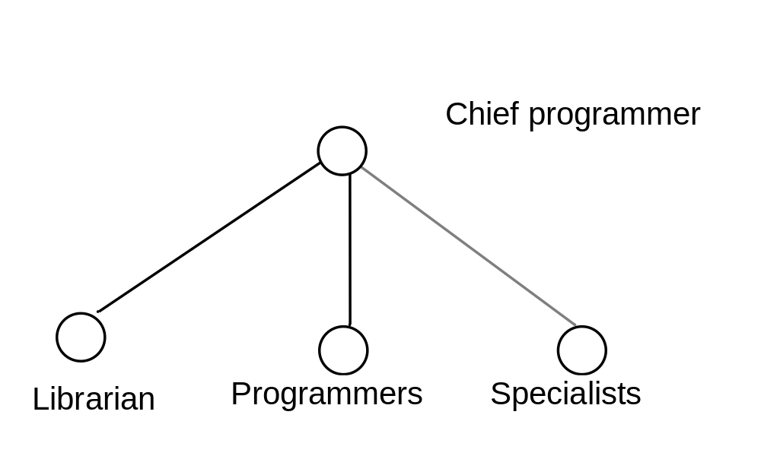
Team structure
Ch. 8

Slide 47
Decentralized team organization
Decisions are made by consensus, and all work is considered group work
Members review each other’s work and are responsible as a group for what every member produces
Best when the problem or solution is not well-understood and requires the contribution of several people to clarify it
Ch. 8

Slide 48
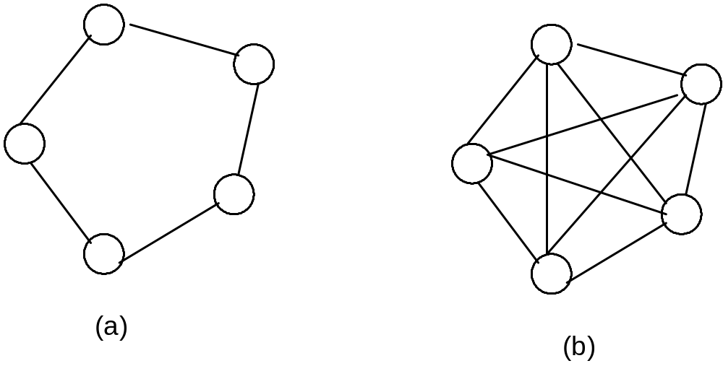
Team structure
management structure
communication pattern
Ch. 8

Slide 49
Mixed-control team organization
Attempts to combine the benefits of centralized and decentralized control
Differentiates engineers into senior and junior
Senior engineer leads a group of juniors and reports to a project manager
Control vested in the project manager and senior programmers
Communication decentralized among each set of individuals, peers, and their immediate supervisors
Ch. 8

Slide 50
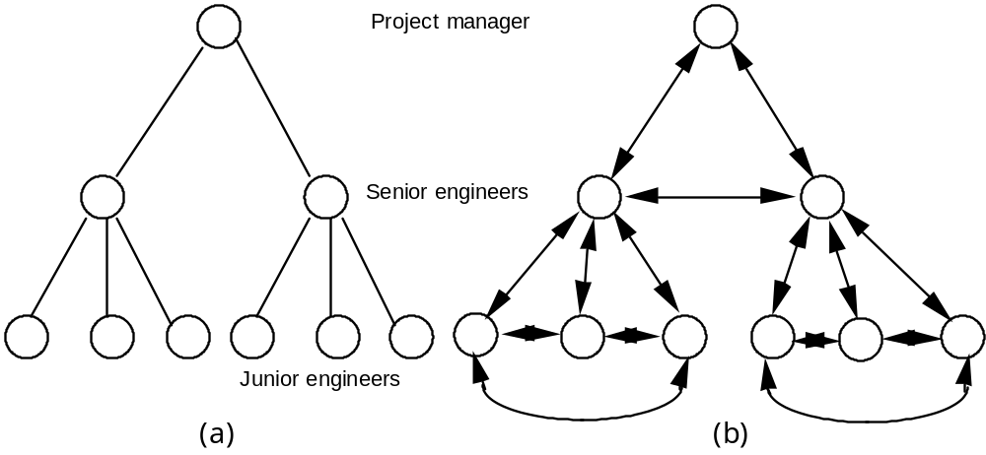
Team structure
management structure
communication pattern
Ch. 8

Slide 51
Case study: open source development
Reliance on volunteer developers and the lack of organized schedule
Team organization is a mixed mode
  each module has a responsible person , who is the ultimate arbiter of what goes into the eventual release of the module
  anyone may review the module and send in corrections and other contributions to the responsible person
Ch. 8

Slide 52
Case study:
Nokia software factories
Ch. 8

Slide 53
Foundational principles
  Geographically distributed environment
    typical project: 100 developers working in three to four sites
    synchronous work not possible (differences in time zones)
  Product family architecture
    architecture developed for an entire family, and components developed to be used in all family members
  Concurrent engineering
    components developed concurrently at different sites, retrieved from the various sites and combined in a central location
  Use of tools
    process is tool supported (for requirements engineering, design, coding, version management, configuration management, and testing)
Ch. 8

Slide 54
Risk management
A topic of management theory
Identifies project risks, assesses their impact, and monitors and controls them
Ch. 8

Slide 55
Typical SE risks (Boehm 1989)
RISK
RISK MANAGEMENT TECHNIQUE
1. Personnel shortfalls
-
Staffing with top talent; job matching; team
building; key
-
personnel agreements; cross
-
training; pre
-
scheduling key people
2. Unrealistic schedules
-
Detailed multisource cost & schedu
le
and budgets
estimation; design to cost; incremental
development; software reuse; requirements
scrubbing
3. Developing the wrong
-
Organization analysis; mission analysis; ops
-
software functions
concept formulation; user surveys; prototyping;
early users’ manuals
4. Developing the wrong
-
Prototyping; scenarios; task analysis; user
user interface
characterization (functionality, style, workload)
Ch. 8

Slide 56
5. Gold plating
-
Requirements scrubbing; prototyping; cost
–
benefit analysis; design to cost
6. Continuing stream of
-
High change threshold; information hiding;
re
quirements
incremental development (defer changes to later
increments)
7. Shortfalls in externally
-
Benchmarking; inspections; reference checking;
furnished components
compatibility analysis
8. Shortfalls in
externally
-
Reference checking; pre
-
award audits; award
-
fee
performed tasks
contracts; competitive design or prototyping;
team building
9. Real
-
time performance
-
Simulation; benchmarking; modeling;
shortfalls
prototyping; instrumentation; tuning
10. S
training computer
-
Technical analysis; cost
–
benefit analysis;
science capabilities
prototyping; reference checking
Ch. 8

Slide 57
Capability Maturity Model
CMM developed by the Software Engineering Institute to help
  organizations which develop software
    to improve their software processes
  organizations which acquire software
    to assess the quality of their contractors
Ch. 8

Slide 58
Maturity
Immature organization
  processes are improvised during the course of a project to resolve unanticipated crises
  products often delivered late and their quality is questionable
Mature organization
  organization-wide standard approach to software processes, known and accepted by all engineers
  focus on continuous improvement both in performance and product quality
Ch. 8

Slide 59
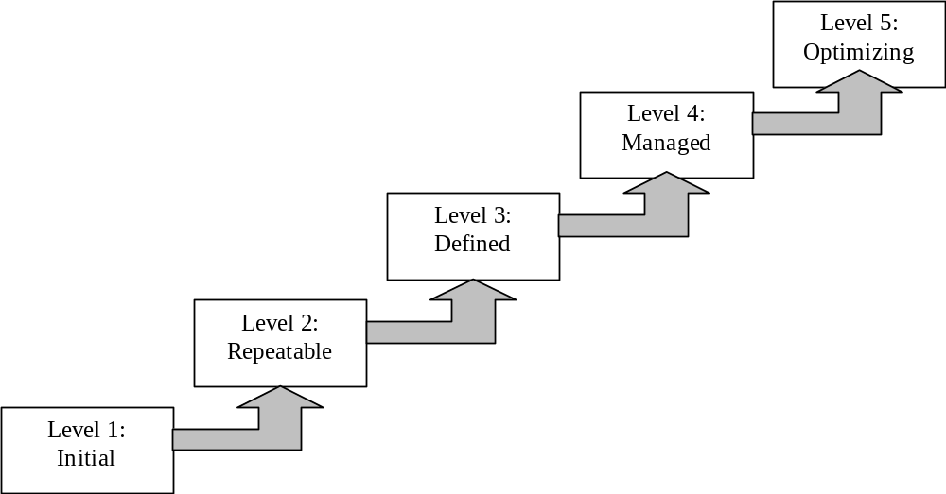
CMM maturity levels
Ch. 8

Slide 60
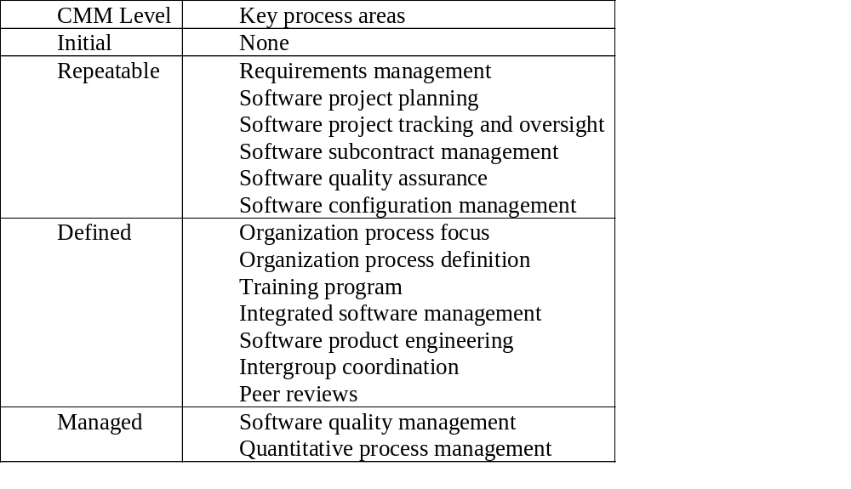
Key process areas
Ch. 8

